Slide 1
Studying state-of-the-art HTAP systems
- Satya Sai Bharath Vemula
- Rwitam Bandyopadhyay
- Shubham Pandey
Milestone 2

Slide 2
Table of Contents
PolarDB (~14 min)
SingleStore (~13 min)
GreenPlum (~13 min)
Project Plan
Notes:
Quickly going through the agenda for today.
We will go through a brief introduction of what HTAP systems are, the challenges involved, and some common HTAP architectural styles.
We will then cover 3 DB systems today and see how they achieve HTAP.

Slide 3
PolarDB
Disagg1
Presented by Shubham Pandey
Notes:
PolarDB is a commercial cloud based DB developed by Alibaba which is compatible with mySQL and postgreSQL.

Slide 4
PolarDB
Introduction
CPU
Memory
Storage
Source: https://www.alibabacloud.com/blog/analyze-the-technical-essentials-of-polardb-at-the-architecture-level_599347
Notes:
Before I jump on to the architecture details of polarDB
A single machine has 3 major components, namely CPU, Memory and Storage. Sometimes it may not be possible for a single machine to handle all the workload and so, we try improving these components to perform better, commonly called the vertical scaling.

Slide 5
PolarDB
Introduction
CPU
CPU
Memory
Memory
Storage
Storage
Scale vertically
Source: https://www.alibabacloud.com/blog/analyze-the-technical-essentials-of-polardb-at-the-architecture-level_599347
Notes:
And we cannot keep doing this becuase after a certain point, we hit state of the art, so we instead resort to horizontal scaling.

Slide 6
PolarDB
Introduction
CPU
CPU
CPU
CPU
CPU
Memory
Memory
Memory
Memory
Memory
Storage
Storage
Local Storage
Local Storage
Local Storage
Scale horizontally
Source: https://www.alibabacloud.com/blog/analyze-the-technical-essentials-of-polardb-at-the-architecture-level_599347
Notes:
And infact now we can have multiple cheaper machine because a single strong machine is no longer in need.

Slide 7
PolarDB
Introduction
CPU
CPU
CPU
CPU
CPU
Memory
Memory
Memory
Memory
Memory
Storage
Storage
Local Storage
Local Storage
Local Storage
CPU
CPU
CPU
CPU
CPU
Memory
Memory
Memory
Memory
Memory
Scale horizontally with
low-end machines
Local Storage
Local Storage
Local Storage
Local Storage
Local Storage
Source: https://www.alibabacloud.com/blog/analyze-the-technical-essentials-of-polardb-at-the-architecture-level_599347
Notes:
Ofcourse there has to be coordination efforts among these machines, but such an architecture has now been adopted in many of the big data systems today.

Slide 8
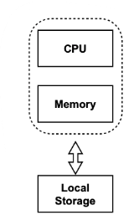
PolarDB
Introduction
Source: https://www.alibabacloud.com/blog/analyze-the-technical-essentials-of-polardb-at-the-architecture-level_599347
Notes:
As you saw that when we were able to horizontally scale, each machine had its local storage.

Slide 9
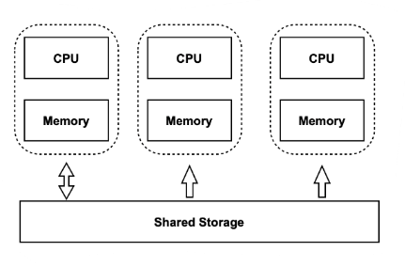
PolarDB
Introduction
Source: https://www.alibabacloud.com/blog/analyze-the-technical-essentials-of-polardb-at-the-architecture-level_599347
Notes:
One more thing that we can do with this architecture is to now have a shared storage instead. This gives extreme elasticity with the storage and computing separation. Now both the computing cluster and storage can be expanded and shrinked independently based on requirements. It is important to pay attention to the direction of arrows between the compute node and the storage. Which brings us closer to the polarDB architecture.

Slide 10
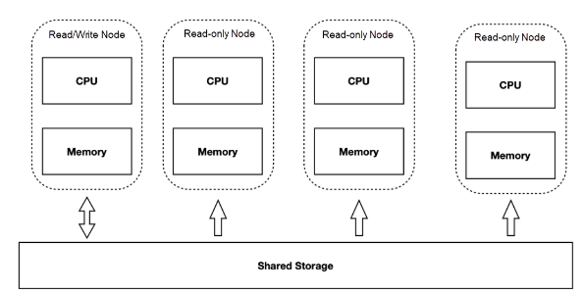
PolarDB
Shared Storage Architecture
Source: https://www.alibabacloud.com/blog/analyze-the-technical-essentials-of-polardb-at-the-architecture-level_599347
Notes:
We have one node that can perform both reads and writes to the shared storage, whereas all the other nodes are read only nodes.

Slide 11
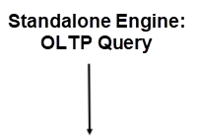
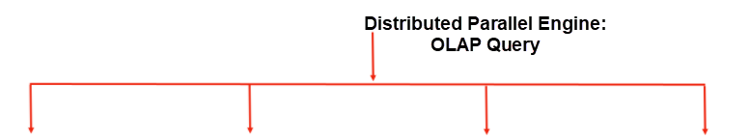
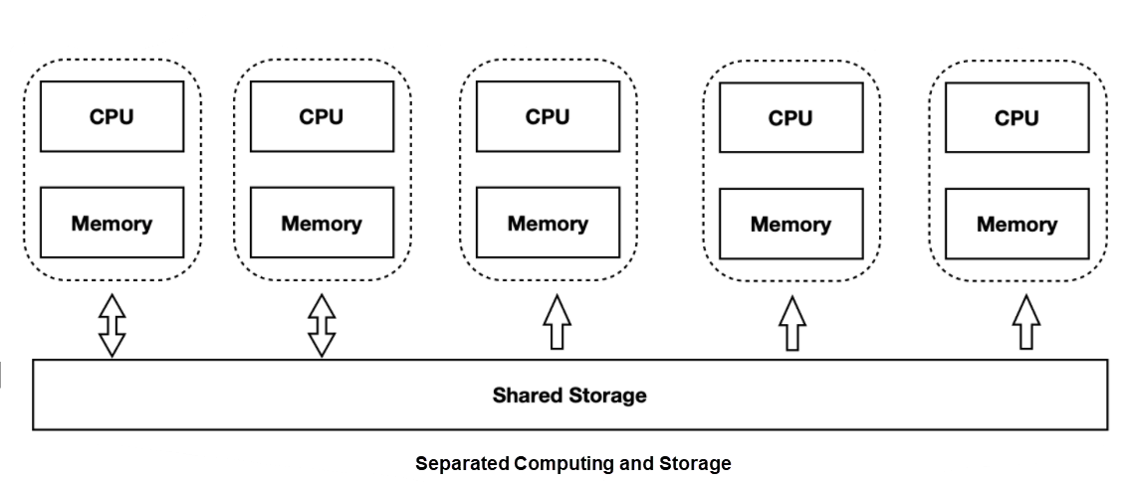
PolarDB
HTAP
Source: https://www.alibabacloud.com/blog/analyze-the-technical-essentials-of-polardb-at-the-architecture-level_599347
Notes:
And the way it fits into the HTAP architecture is actually the introduction of standalone execution engine for OLTP type loads, and a distributed execution engine for OLAP loads.

Slide 12
PolarDB
Challenges Posed by Shared Storage
Data Consistency
Read/Write Splitting
High Availability
Source: https://www.alibabacloud.com/blog/analyze-the-technical-essentials-of-polardb-at-the-architecture-level_599347
Notes:
But there are several challenges with shared storage and my objective today would be to discuss those and show how they have been solved.
Since we have one storage shared across multiple compute nodes, we have to address Data Consistency . In case of nodes have different responsibilities in terms of reads and writes, we have to make sure that the replication based on new architecture has low latency.
And then we have concerns like making the system highly available by having recovery and failover mechanisms. So lets get into how polarDB has addresssed such issues
.

Slide 13
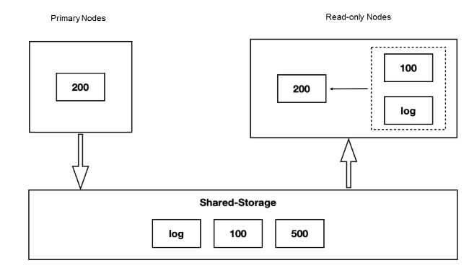
PolarDB
Data Consistency
Source: https://www.alibabacloud.com/blog/analyze-the-technical-essentials-of-polardb-at-the-architecture-level_599347
Notes:
In traditional shared nothing db, you only need to copy write ahead logs from primary to secondary nodes and play them back. But in case of shared storage, although the pages in shared storage are consistent, the pages buffered in memory may be stale in secondary nodes, so the log has to be replayed to keep those up to date.

Slide 14
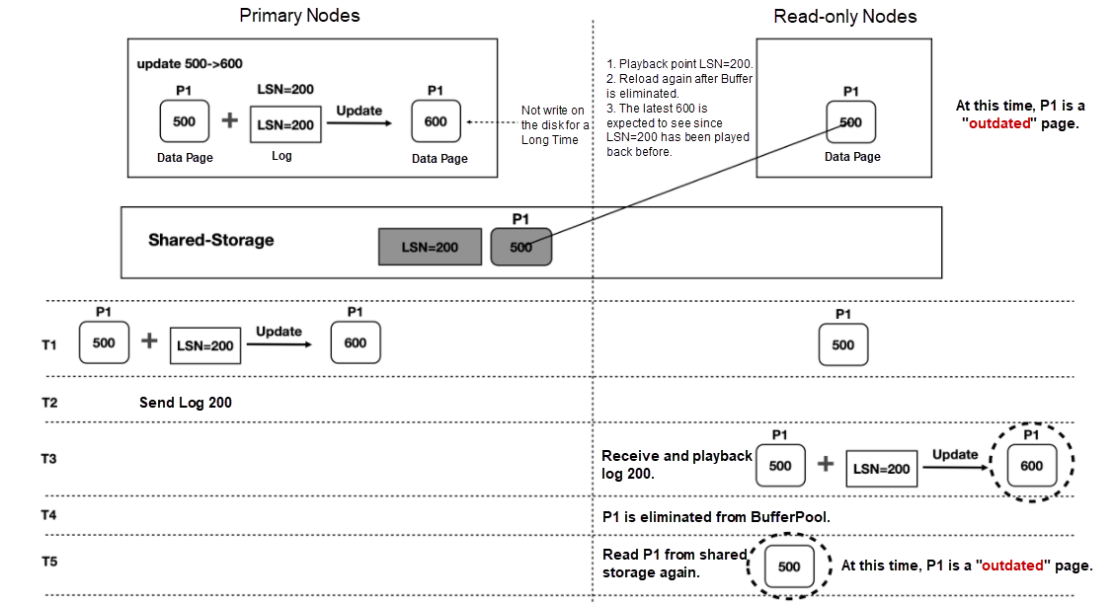
PolarDB
Outdated Pages (Problem)
Source: https://www.alibabacloud.com/blog/analyze-the-technical-essentials-of-polardb-at-the-architecture-level_599347
Notes:
<explain the problem, stating the scenario where the updated data is only in buffer of primary and WAL in shared storage>

Slide 15
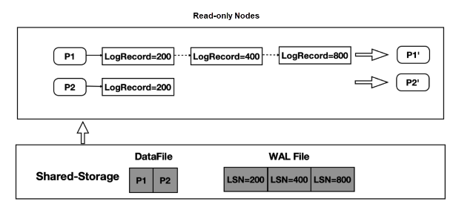
PolarDB
Outdated Pages (Solution)
Source: https://www.alibabacloud.com/blog/analyze-the-technical-essentials-of-polardb-at-the-architecture-level_599347
Notes:
They introduce a new data structure called log index.
Note that this chain cannot keep growing because the pages in the buffer cache of primary node would eventually be persisted, and when they are, the required updates are also made to the index.
there is also a problem of future pages, but I will not discuss that in this presentation.

Slide 16
PolarDB
Session Read Consistency (Problem)
connection query
{
UPDATE user SET name = "Jimmy" WHERE id=1;
COMMIT
SELECT name FROM user WHERE id=1;
}
Source: PolarDB Series (5): Session Read Consistency - Alibaba Cloud Community

Slide 17
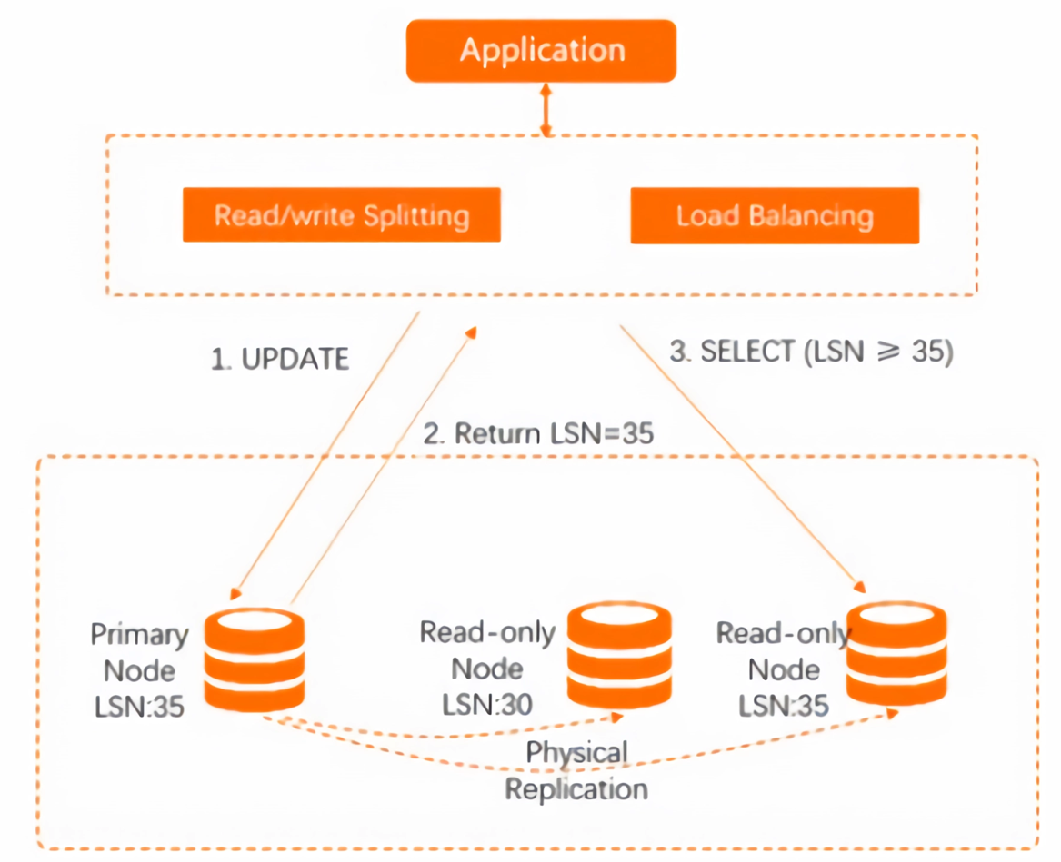
PolarDB
Session Read Consistency (Solution)
Source: PolarDB Series (5): Session Read Consistency - Alibaba Cloud Community
Notes:
The load balancer can also be smart to relay the read request to read replica that is not lagging behind

Slide 18
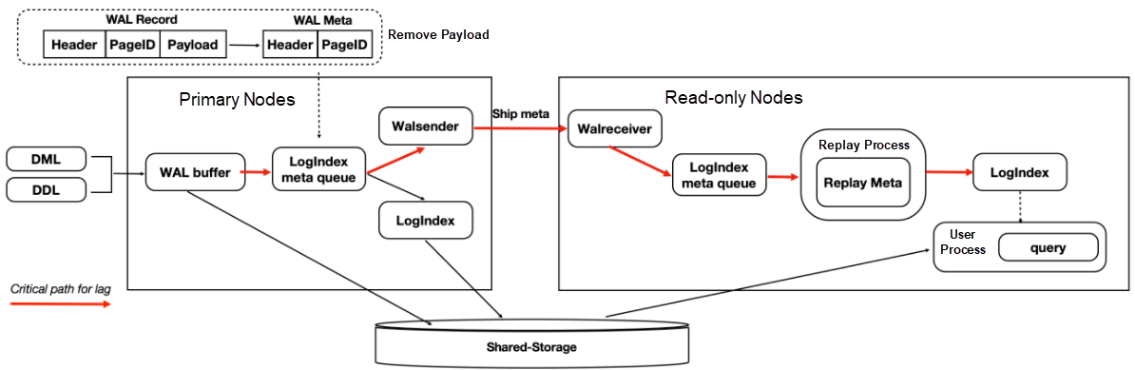
PolarDB
Low Latency Replication (1)
Copy Meta Only
Source: https://www.alibabacloud.com/blog/analyze-the-technical-essentials-of-polardb-at-the-architecture-level_599347
Notes:
Now lets see how they make sure that replication process is not just consistent but also fast.
We exploit the fact that since the WAL details are already present in shared storage, the only thing that needs to be shipped to the secondary nodes is the metadata.

Slide 19
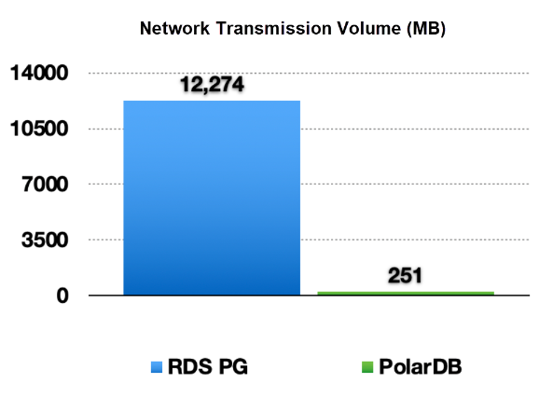
PolarDB
Low Latency Replication (1)
Copy Meta Only
Source: https://www.alibabacloud.com/blog/analyze-the-technical-essentials-of-polardb-at-the-architecture-level_599347
Notes:
Relational Database Service, Postgre SQL (RDS PG), reduces the transmission volume by 98%. Which means on an average, each log records has 2% metadata and 98% is the actual record that needs to be replayed in the secondary nodes, or in the event of crash, for the primary node.

Slide 20
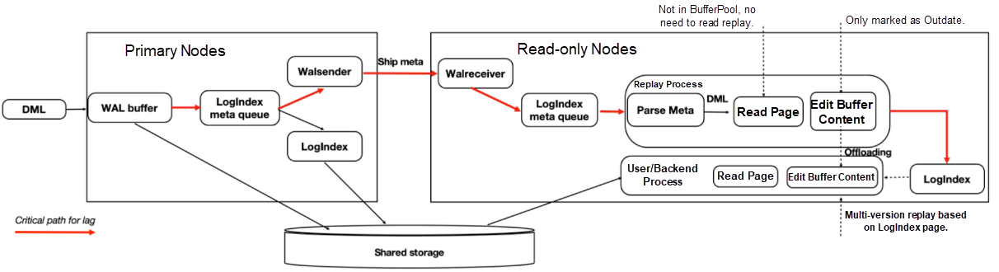
PolarDB
Low Latency Replication (2)
Page Replay Optimization
Source: https://www.alibabacloud.com/blog/analyze-the-technical-essentials-of-polardb-at-the-architecture-level_599347
Notes:
Offload some of the log replay operations to session process (the one initiated by user during reads thereby making it lazy updates). Also, do not read the page from the disk if it is not in the buffer pool, only record the log index for it so in future when you read that page, you apply the logs.
And for pages in the buffer, just outdate them, and leave for the session process to update it!

Slide 21
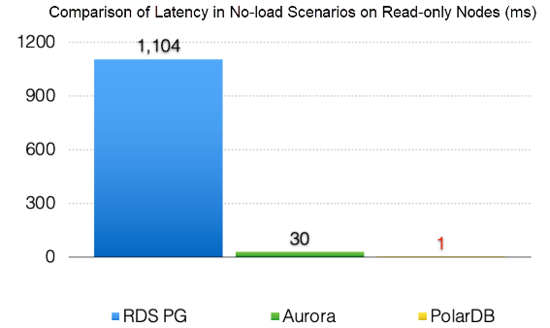
PolarDB
Low Latency Replication (2)
Page Replay Optimization
Source: https://www.alibabacloud.com/blog/analyze-the-technical-essentials-of-polardb-at-the-architecture-level_599347
Notes:
Offload some of the log replay operations to session process (the one initiated by user during reads thereby making it lazy updates). Also, do not read the page from the disk if it is not in the buffer pool, only record the log index for it.

Slide 22
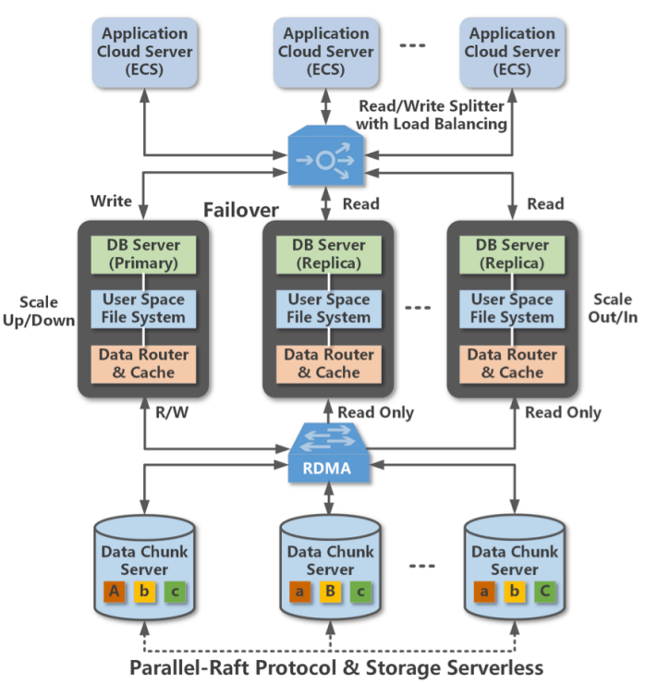
PolarDB
Fault Tolerance
Active-Active-Failover
Shared Storage
Source: https://www.alibabacloud.com/blog/analyze-the-technical-essentials-of-polardb-at-the-architecture-level_599347
Notes:
Talking about how polarDB handles failures of master nodes, it has active-active-failover architecture, which means that all the nodes are actively participating in serving the client requests and if primary goes down, one of the secondary node is promoted to be the new primary.

Slide 23
PolarDB
Shared Storage
Chunk Servers
Proxy
RDMA
Parallel-Raft
Source: https://www.alibabacloud.com/blog/analyze-the-technical-essentials-of-polardb-at-the-architecture-level_599347
Notes:
All this time we were talking about the shared storage in an abstract way, and we were treating this as a single unit. But it is actually composed of multiple chunk servers where each chunk server is a leader for a subset of data. In this case you can see that the first is leader for A, and other two are followers, and so on.
The proxy layer in between maintains all of this metadata, so whenever it receives any reqest for writes, it knows what chunk server is the leader for it. Note that RDMA is used for low latency server communication.
Also notice that they have come up with the modified version of Raft called the Parallel-Raft which capitalizes on the idea that when different threads work on different pages concurrently, database only need the I/Os be executed successfully, their completion order would not matter.
The proxy keeps track of election and then redirects traffic to the new leader

Slide 24
SingleStore
Disagg1
Presented by Satya Sai Bharath Vemula
Notes:
We will now look at the first system for today, the Oracle Dual Format In-Memory Database.

Slide 25
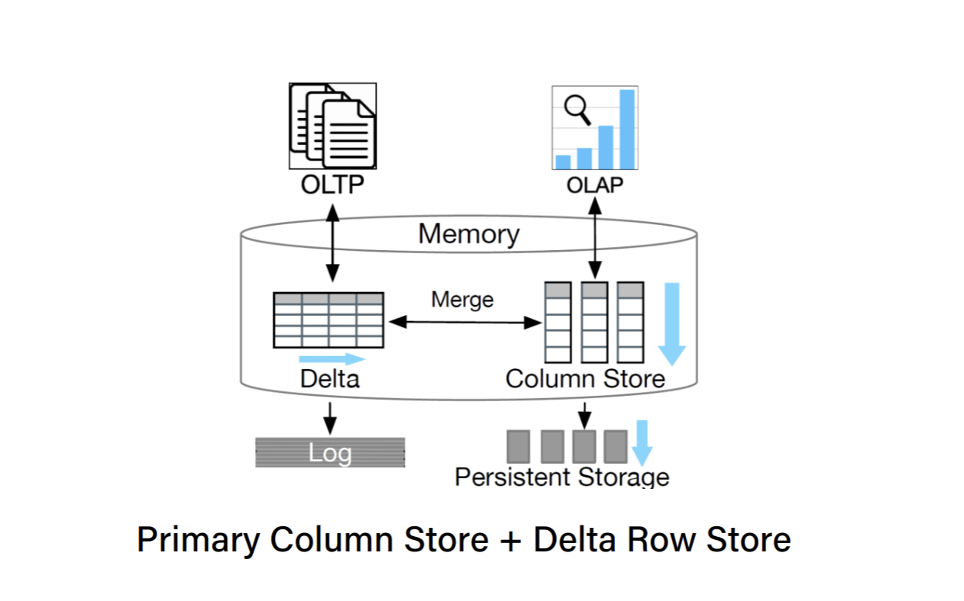
SingleStore
Introduction / System Features
A Cloud native HTAP Database, Upgraded version of MemSQL.
Column Store is the first-class citizen (i.e., data is persisted in columnar format), Row store is stored in memory
Highly-scalable Distributed database
SQL Compatible
Source:
Source: HTAP Databases: What is New and What is Next | Proceedings of the 2022 International Conference on Management of Data (acm.org)
Notes:
A single machine has 3 major components, namely CPU, Memory and Storage. Sometimes it may not be possible for a single machine to handle all the workload and so, we try improving these components to perform better, commonly called the vertical scaling. And we cannot keep doing this becuase after a certain point, we hit state of the art, so we instead resort to horizontal scaling. And infact now we can have multiple cheaper machine because a single strong machine is no longer in need. Ofcourse there has to be coordination efforts among these machines, but such an architecture has now been adopted in many of the big data systems today.

Slide 26
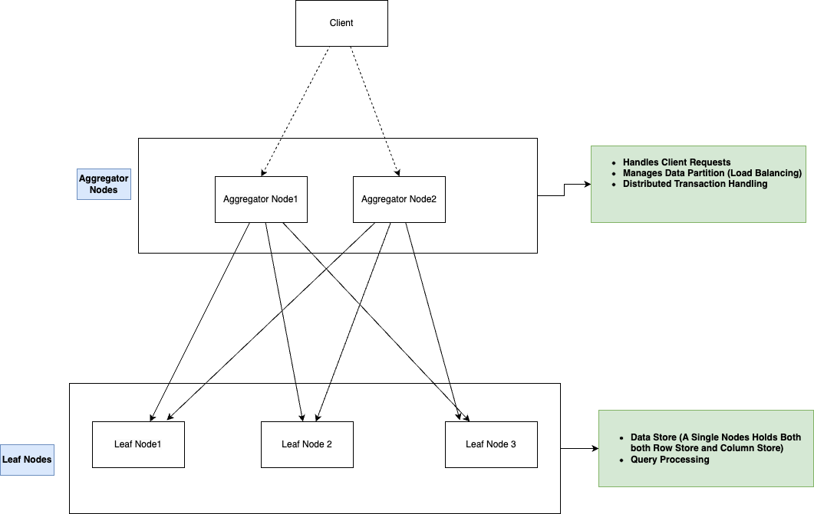
SingleStore
Architecture
Notes:
A single machine has 3 major components, namely CPU, Memory and Storage. Sometimes it may not be possible for a single machine to handle all the workload and so, we try improving these components to perform better, commonly called the vertical scaling. And we cannot keep doing this becuase after a certain point, we hit state of the art, so we instead resort to horizontal scaling. And infact now we can have multiple cheaper machine because a single strong machine is no longer in need. Ofcourse there has to be coordination efforts among these machines, but such an architecture has now been adopted in many of the big data systems today.

Slide 27
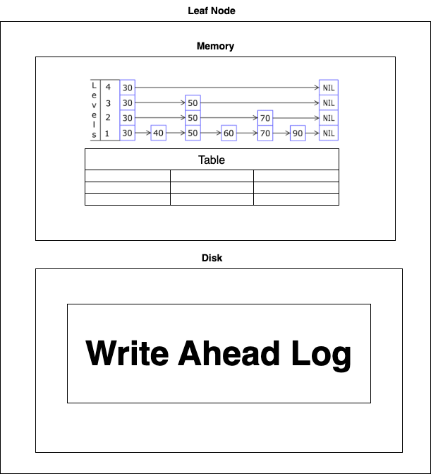
SingleStore
Row Store
OLTP queries are honored using the in-memory row store
Row store in the memory is built as a skip list index Table (ordered on key) where the leaf nodes contain the row tuple
Write ahead log ensures changes are persisted to disk
Since Memory if only a fraction of disk space, Only Hot data is placed inside the in-memory Row store
Source: https://saince.io/2022/10/19/singlestore-the-one-ring-to-rule-them-all/

Slide 28
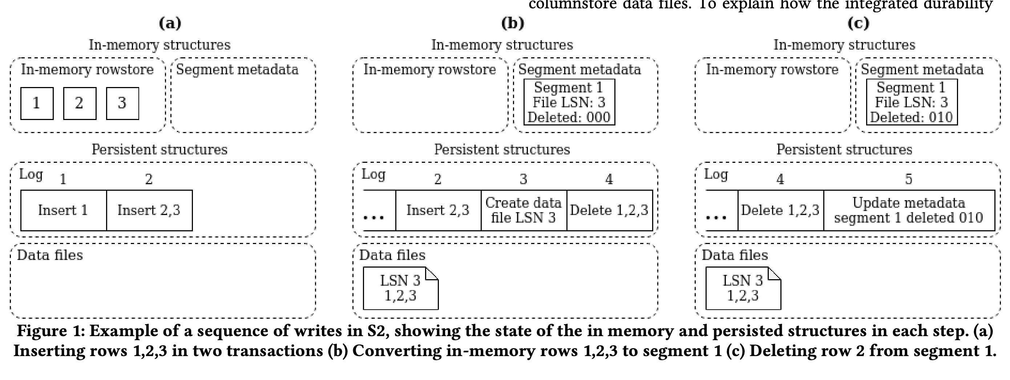
SingleStore
Column Store & Data Sync
Source: https://images.go.singlestore.com/Web/MemSQL/%7Bd1e77ba1-0e3e-4194-8438-2e289cb2b87c%7D_research-paper-cloud-native-transactions-and-analytics-in-singlestore.pdf

Slide 29
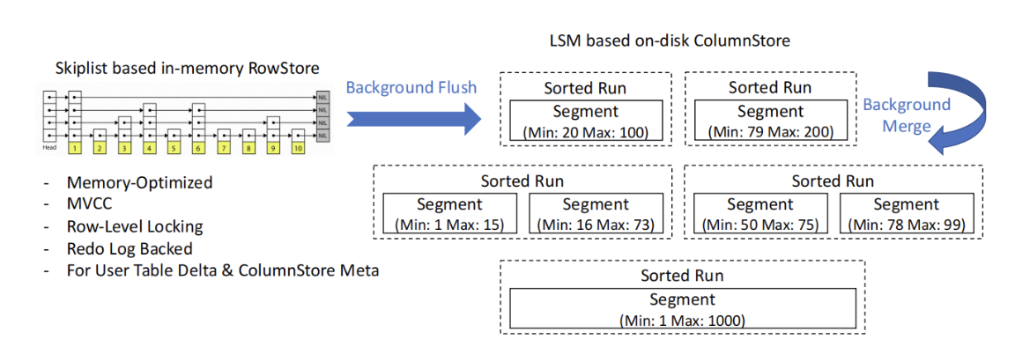
SingleStore
Column Store Merge
Source: https://saince.io/2022/10/19/singlestore-the-one-ring-to-rule-them-all/

Slide 30
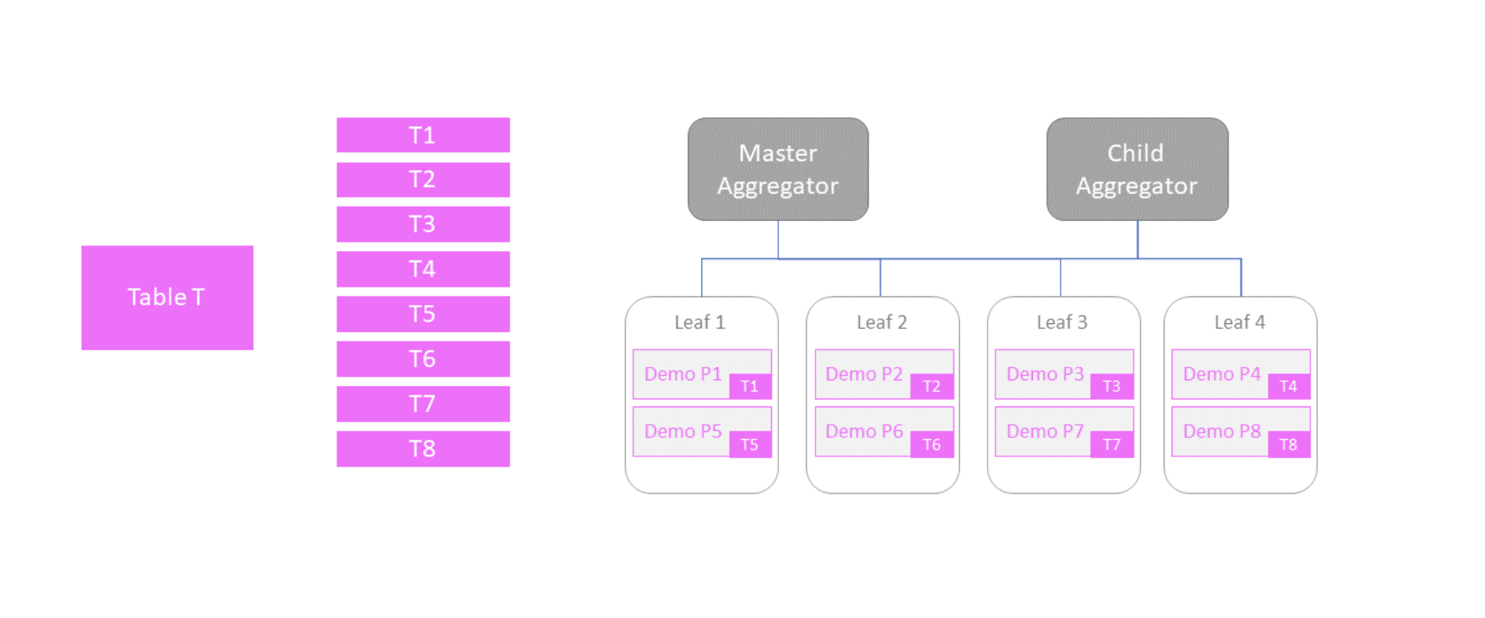
SingleStore
Scalability
Source: https://saince.io/2022/10/19/singlestore-the-one-ring-to-rule-them-all/
Notes:
A single machine has 3 major components, namely CPU, Memory and Storage. Sometimes it may not be possible for a single machine to handle all the workload and so, we try improving these components to perform better, commonly called the vertical scaling. And we cannot keep doing this becuase after a certain point, we hit state of the art, so we instead resort to horizontal scaling. And infact now we can have multiple cheaper machine because a single strong machine is no longer in need. Ofcourse there has to be coordination efforts among these machines, but such an architecture has now been adopted in many of the big data systems today.

Slide 31
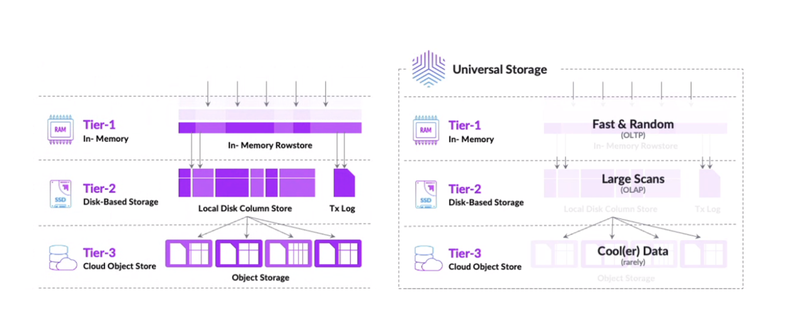
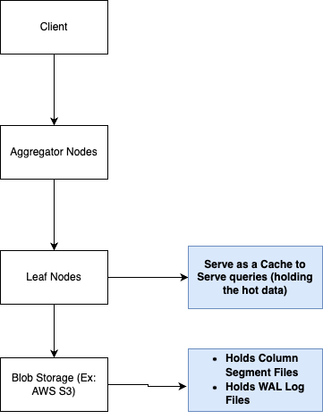
SingleStore
Bottomless Architecture / 3 Tier Architecture
Source: https://saince.io/2022/10/19/singlestore-the-one-ring-to-rule-them-all/
Notes:
A single machine has 3 major components, namely CPU, Memory and Storage. Sometimes it may not be possible for a single machine to handle all the workload and so, we try improving these components to perform better, commonly called the vertical scaling. And we cannot keep doing this becuase after a certain point, we hit state of the art, so we instead resort to horizontal scaling. And infact now we can have multiple cheaper machine because a single strong machine is no longer in need. Ofcourse there has to be coordination efforts among these machines, but such an architecture has now been adopted in many of the big data systems today.

Slide 32
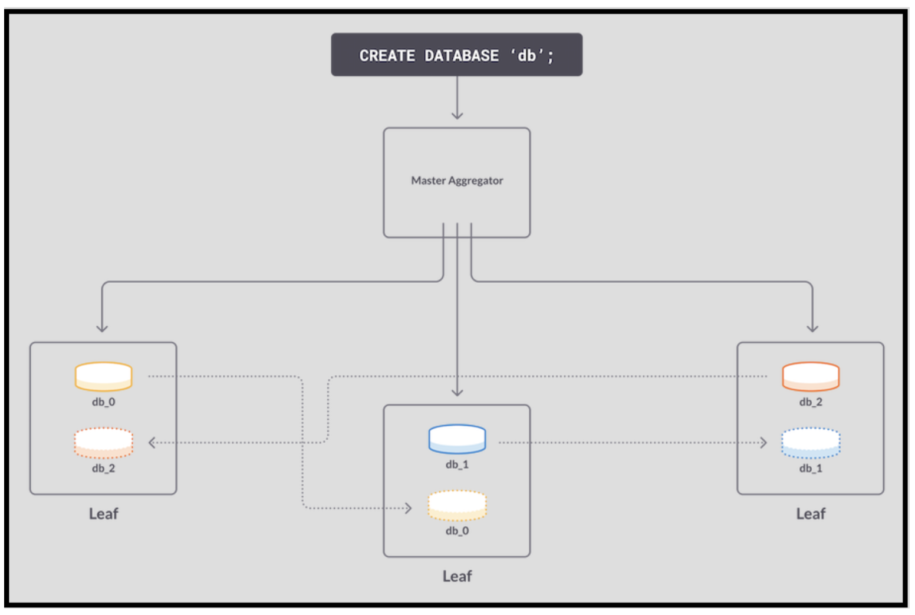
SingleStore
Availability
High Availability is enabled by Replication, with two node configuration
Primary
Replica
Number of Replicas for each partition can be configurable
Replication happens in a synchronous way.
Replicas are by default only for Durability of data and are not responsible for handling client requests
Source: https://saince.io/2022/10/19/singlestore-the-one-ring-to-rule-them-all/
Notes:
A single machine has 3 major components, namely CPU, Memory and Storage. Sometimes it may not be possible for a single machine to handle all the workload and so, we try improving these components to perform better, commonly called the vertical scaling. And we cannot keep doing this becuase after a certain point, we hit state of the art, so we instead resort to horizontal scaling. And infact now we can have multiple cheaper machine because a single strong machine is no longer in need. Ofcourse there has to be coordination efforts among these machines, but such an architecture has now been adopted in many of the big data systems today.

Slide 33
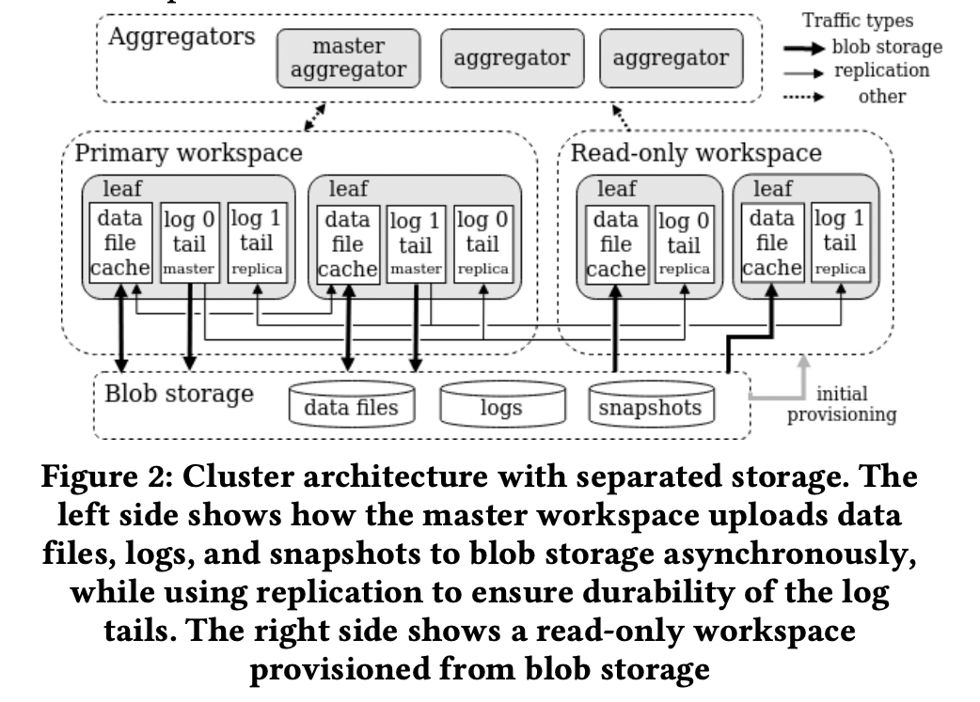
SingleStore
Availability (Read Replica)
Source: https://images.go.singlestore.com/Web/MemSQL/%7Bd1e77ba1-0e3e-4194-8438-2e289cb2b87c%7D_research-paper-cloud-native-transactions-and-analytics-in-singlestore.pdf
Notes:
A single machine has 3 major components, namely CPU, Memory and Storage. Sometimes it may not be possible for a single machine to handle all the workload and so, we try improving these components to perform better, commonly called the vertical scaling. And we cannot keep doing this becuase after a certain point, we hit state of the art, so we instead resort to horizontal scaling. And infact now we can have multiple cheaper machine because a single strong machine is no longer in need. Ofcourse there has to be coordination efforts among these machines, but such an architecture has now been adopted in many of the big data systems today.

Slide 34
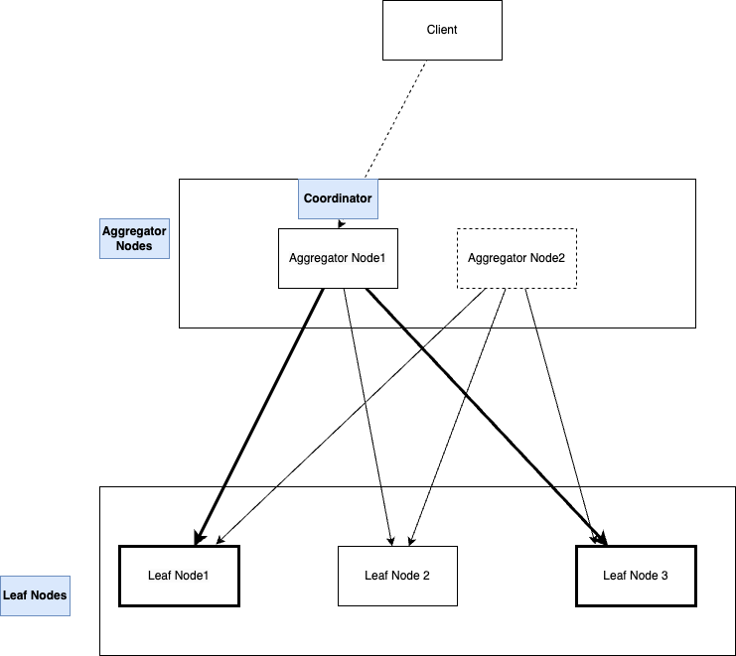
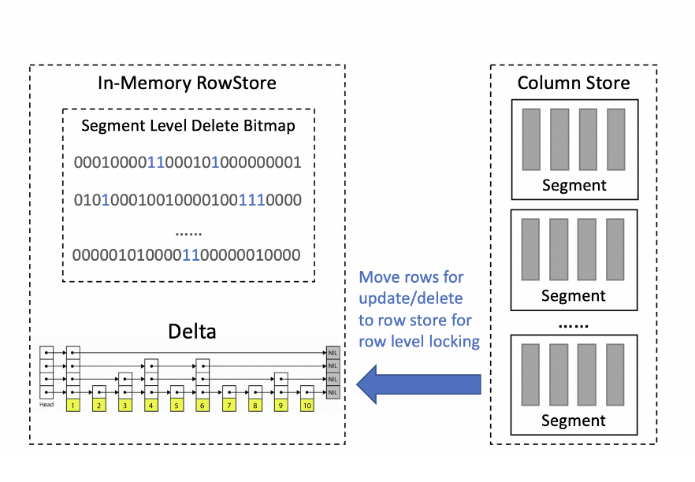
SingleStore
OLTP Query Processing
Source: https://images.go.singlestore.com/Web/MemSQL/%7Bd1e77ba1-0e3e-4194-8438-2e289cb2b87c%7D_research-paper-cloud-native-transactions-and-analytics-in-singlestore.pdf
Notes:
A single machine has 3 major components, namely CPU, Memory and Storage. Sometimes it may not be possible for a single machine to handle all the workload and so, we try improving these components to perform better, commonly called the vertical scaling. And we cannot keep doing this becuase after a certain point, we hit state of the art, so we instead resort to horizontal scaling. And infact now we can have multiple cheaper machine because a single strong machine is no longer in need. Ofcourse there has to be coordination efforts among these machines, but such an architecture has now been adopted in many of the big data systems today.

Slide 35
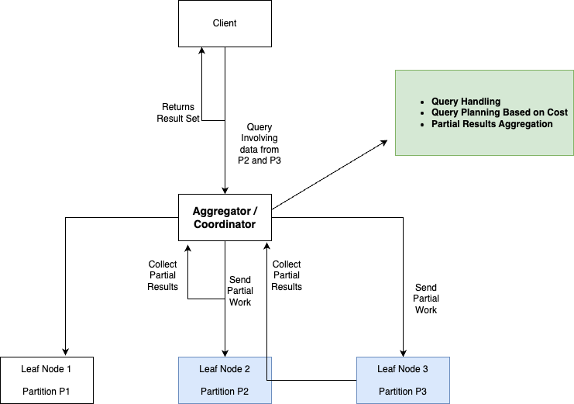
SingleStore
OLAP Query Processing
Notes:
A single machine has 3 major components, namely CPU, Memory and Storage. Sometimes it may not be possible for a single machine to handle all the workload and so, we try improving these components to perform better, commonly called the vertical scaling. And we cannot keep doing this becuase after a certain point, we hit state of the art, so we instead resort to horizontal scaling. And infact now we can have multiple cheaper machine because a single strong machine is no longer in need. Ofcourse there has to be coordination efforts among these machines, but such an architecture has now been adopted in many of the big data systems today.

Slide 36

Greenplum DB
Disagg1
Presented by Rwitam Bandyopadhyay

Slide 37
Background and History
Greenplum is an established large-scale data-warehouse system.
Designed with OLAP Queries as the first-class citizen.
There is always a performance tradeoff between OLAP and OLTP.
Greenplum Version 6 (introduced in 2019) featured massive gains in OLTP Performance. Below shows a community conducted comparison of INSERT performances.
How an OLAP system was transformed into an HTAP system?
MySQL 5.6 | Greenplum 6.2.1
1926/second | 2252/second

Slide 38
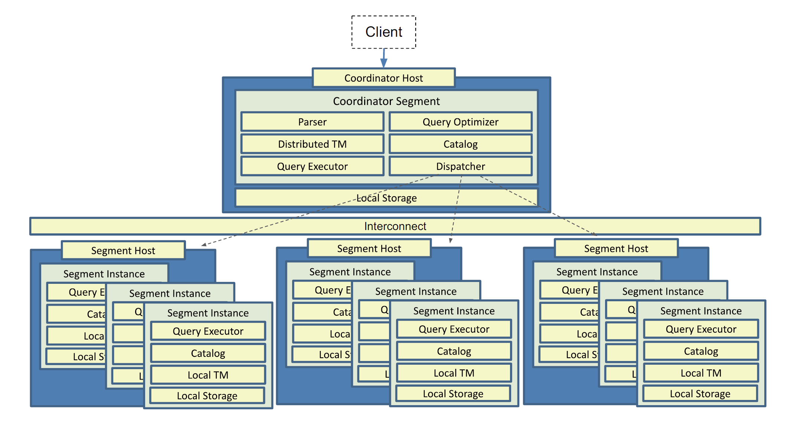
Greenplum Architecture
It uses Massively Parallel Processing (MPP) Architecture
Coordinator Segment
Segment
Source: Lyu, Zhenghua et al. Greenplum: A Hybrid Database for Transactional and Analytical Workloads, SIGMOD '21: Proceedings of the 2021 International Conference on Management of Data.
Notes:
A Greenplum cluster consists of many segments across many hosts.
NEXT SLIDE
There is only one segment called the coordinator segment in the whole database system. The others are called segments for short.
The coordinator segment is directly connected to user clients. The coordinator receives commands or queries from them, generates a distributed query plan, spawns distributed processes according to the plan, dispatches it to each process, gathers the results, and finally sends back to the clients.
NEXT SLIDE
Segments serve as the primary storage of user data and execute a specific part of the distributed plan from coordinator. To achieve high availability, some segments are configured as mirrors (or standbys for the coordinator). Mirrors (and standbys) will not participate in computing directly. Instead, they receive WAL logs from their corresponding primary segments continuously and replay the logs on the fly.
Greenplum follows a shared-nothing architecture. The coordinator and segments have their own shared memory and data directory. Coordinator communicates with segments only through networks.
FAULT TOLERANCE
The Greenplum Database master instance is clients' single point of access to the system. The master instance stores the global system catalog, the set of system tables that store metadata about the database instance, but no user data. If an unmirrored master instance fails or becomes inaccessible, the Greenplum instance is effectively off-line, since the entry point to the system has been lost. For this reason, a standby master must be ready to take over if the primary master fails. That is a “warm standby” which keeps track of the system state by using WALs from the Coordinator Host and takes over if the master fails.

Slide 39
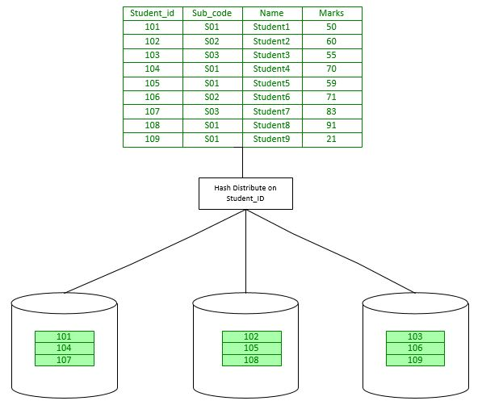
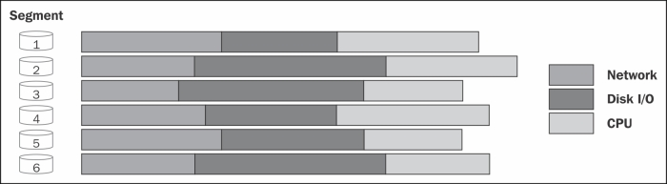
Greenplum Architecture (Continued)
Data Distribution
Data Access Times
Source: Greenplum Table Distribution and Best Practices, Greenplum table distribution and partitioning
Notes:
In an MPP shared nothing environment, overall response time for a query is measured by the completion time for all segments. If the data is skewed, the segments with more data will have a longer completion time. The optimal goal is that each segment should have a comparable number of rows and perform approximately the same amount of processing.

Slide 40
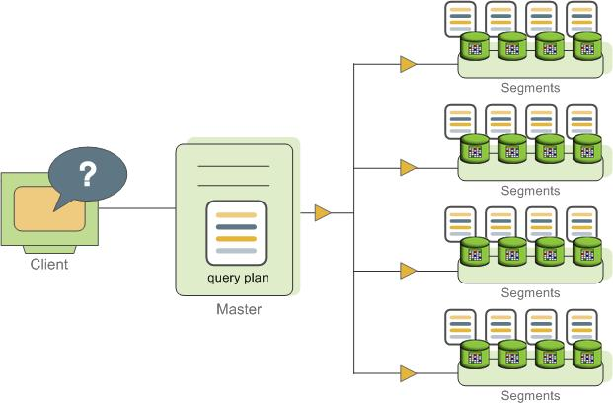
Distributed Query Execution
Coordinator Host Dispatches A Distributed Plan To Segments
Source: VMware Tanzu™ Greenplum® Documentation
Notes:
The coordinator receives, parses, and optimizes the query. The resulting query plan is either parallel or targeted. The master dispatches parallel query plans to all segments. Each segment is responsible for running local database operations on its own set of data.
Certain queries may access only data on a single segment, such as single-row INSERT, UPDATE, DELETE, or SELECT operations or queries that filter on the table distribution key column(s). In queries such as these, the query plan is not dispatched to all segments, but is targeted at the segment that contains the affected or relevant row(s).

Slide 41
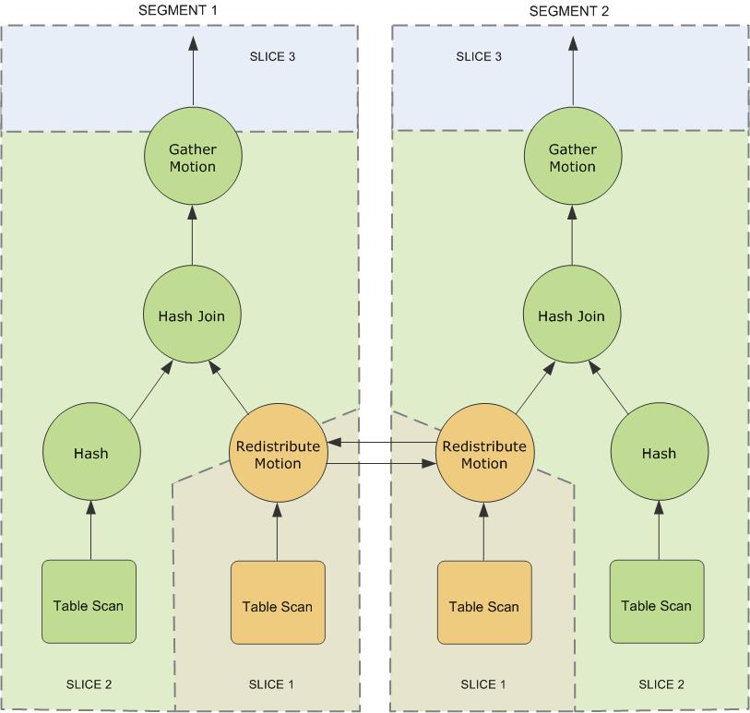
Motions & Query Slice Plans
Motions involves moving tuples between segments
Source: VMware Tanzu™ Greenplum® Documentation
Notes:
Motion Operators
Broadcast motion
Every segment sends its own local data to all other segment instances so that every segment instance has a complete local copy of the table.
Redistribution motion
Sends data from one table to another segment so that matching rows are located together, enabling a local join.
Gather motion
All segments send rows to the master where they are gathered into a single result set.

Slide 42
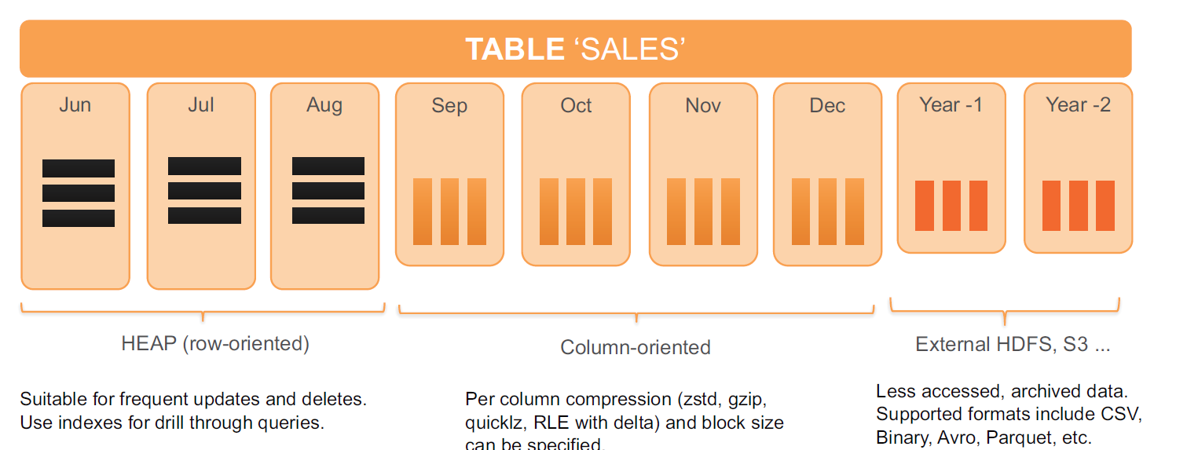
Table Storage Types
The query execution engine is agnostic to table storage type
Source: Lyu, Zhenghua et al. Greenplum: A Hybrid Database for Transactional and Analytical Workloads, SIGMOD '21: Proceedings of the 2021 International Conference on Management of Data.
Notes:
We can have multiple storage types underneath the tables.
We have append-optimized row-oriented storage and append-optimized column-oriented storage.
These AO tables favour bulk I/O over random access making them more suitable for analytic workloads.
Query optimization is workload dependent. Analytical workloads are composed of ad-hoc and complex queries involving many joins and aggregates. Query performance is mainly determined by the efficiency of the query plan.
On the other hand, transactional workloads are composed of short queries, which are sensitive to query planning latency. It requires optimizer to be fast when generating a simple plan. Greenplum’s MPP-aware version of the PostgreSQL optimizer is suitable for such transactional workloads.

Slide 43
Greenplum OLTP Optimizations
Object Lock Optimizations
Global Deadlock Detection (GDD)
Distributed Transaction Management
Resource Isolation
Notes:
Here are some of the optimizations that Greenplum does to better their OLTP performance.

Slide 44
Object Lock Optimizations
Lock Mode | Level | Conflict Lock Level | Typical Statements
AccessShareLock | 1 | 8 | Pure SELECT
RowShareLock | 2 | 7, 8 | SELECT FOR UPDATE, UPDATE, DELETE
RowExclusiveLock | 3 | 5, 6, 7, 8 | INSERT
ShareUpdateExclusiveLock | 4 | 4, 5, 6, 7, 8 | VACUUM (not FULL)
ShareLock | 5 | 3, 4, 6, 7, 8 | CREATE INDEX
ShareRowExclusiveLock | 6 | 3, 4, 5, 6, 7, 8 | CREATE COLLATION
ExclusiveLock | 7 | 2, 3, 4, 5, 6, 7, 8 | REFRESH MATERIALIZED VIEW
AccessExclusiveLock | 8 | 1, 2, 3, 4, 5, 6, 7, 8 | ALTER TABLE
Source: Lyu, Zhenghua et al. Greenplum: A Hybrid Database for Transactional and Analytical Workloads, SIGMOD '21: Proceedings of the 2021 International Conference on Management of Data.
Notes:
Object lock optimization is the cornerstone of Greenplum’s remarkable OLTP performance.
Some objects such as relations, can be concurrently manipulated by transactions. When accessing such an object, locks should be held in a correct mode to protect the object.
Greenplum adopts two phase locking: locks are held in the first phase, and released when transactions are committed or aborted.
Traditional PostgreSQL lock logic does not detect or resolve the global deadlock use case frequently encountered in an MPP database like Greenplum.
For example, most alter table statements will change the catalog and affect optimizer to generate a plan, so these alter table statements are not allowed to be concurrently running with any other statements operating on the same relation.

Slide 45
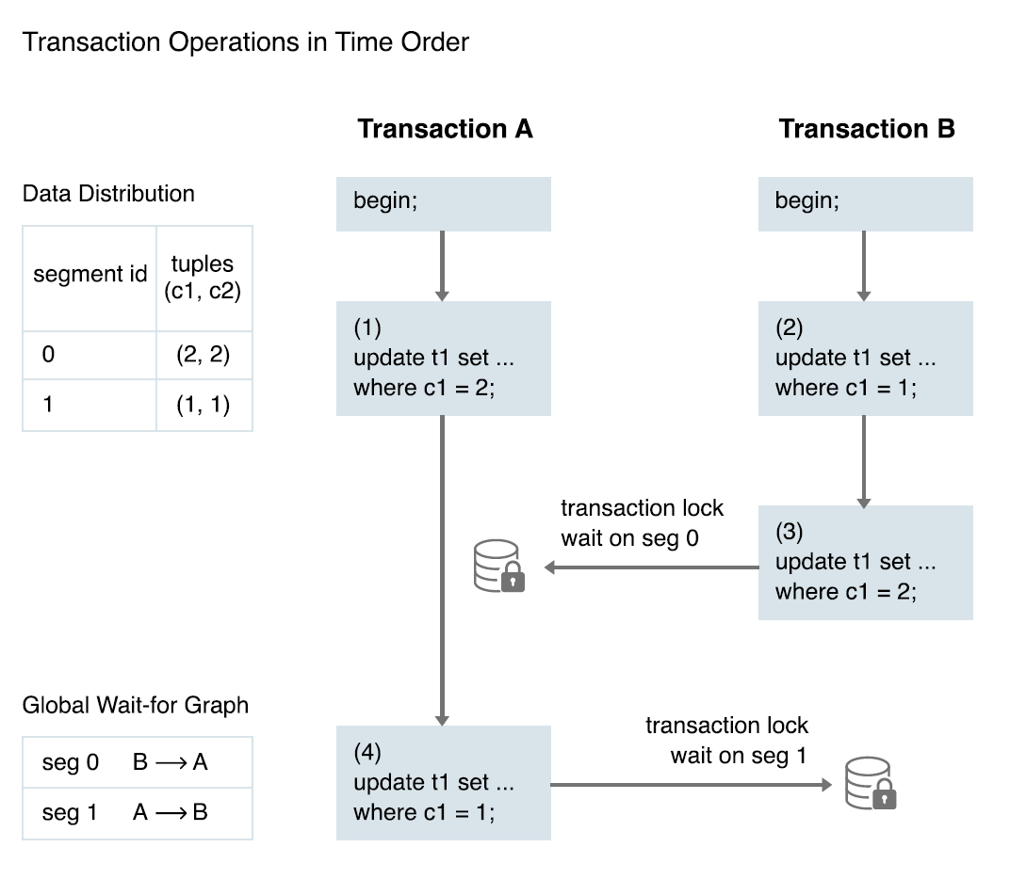
Global Deadlock Detection (GDD)
Source: Lyu, Zhenghua et al. Greenplum: A Hybrid Database for Transactional and Analytical Workloads, SIGMOD '21: Proceedings of the 2021 International Conference on Management of Data.
Notes:
In a distributed database system like Greenplum, how de we ensure transactional consistency? The enhanced object locking mechanisms help to some extent, by preventing unnecessary locks on the whole relation and just on specific rows which are required.
We are bound to run into deadlocks involving multiple segments. Let’s look at this example.
EXPLAIN EXAMPLE
The Greenplum Database Global Deadlock Detector background worker process collects lock information on all segments and uses a directed algorithm to detect the existence of local and global deadlocks, by constructing wait-for-graphs on each segment. By default, the Global Deadlock Detector is disabled, and Greenplum Database runs the concurrent UPDATE and DELETE operations on a heap table serially.
If the Global Deadlock Detector determines that deadlock exists, it breaks the deadlock by cancelling one or more backend processes associated with the youngest transaction(s) involved.
Now does this cause additional overhead?
With GDD enabled, the UPDATE and INSERT’s lock level is downgraded compared to the previous version of Greenplum (GPDB 5 UPDATES and DELETES were Exclusive Lock). Thus, transactions that update or delete the same relation can run
in parallel. The GDD daemon only periodically executes a simple call to fetch wait-for graphs from segments, so it does not consume much resource in the cluster.

Slide 46
Distributed Transaction Management
Each transaction is assigned a unique transaction ID (XID), an incrementing 32-bit value.
When a transaction inserts a row, the XID is saved with the row in the xmin system column.
When a transaction deletes a row, the XID is saved in the xmax system column.
Updating a row is treated as a delete and an insert, so the XID is saved to the xmax of the current row and the xmin of the newly inserted row.
The xmin and xmax columns, together with the transaction completion status, specify a range of transactions for which the version of the row is visible.
Notes:
MVCC is a tried & tested approach to let concurrent transactions proceed without blocking by creating multiple versions of a tuple instead of updating it in-place. Each version is stamped with the creating transaction’s ID.
Greenplum extends this concept by adding distributed snapshots to achieve transaction isolation in a distributed setting. Tuple visibility is determined by combining local and distributed snapshot information.
EXPLAIN XID, xmin and xmax as on slide.
A transaction can see the effects of all transactions less than xmin, which are guaranteed to be committed, but it cannot see the effects of any transaction greater than or equal to xmax.

Slide 47
Distributed Transaction Management (Continued)
Multi-statement transactions also record which command within a transaction inserted a row (cmin) or deleted a row (cmax).
The segments maintain a mapping of distributed transaction IDs with their local XIDs.
Notes:
Multi-statement transactions must also record which command within a transaction inserted a row (cmin) or deleted a row (cmax) so that the transaction can see changes made by previous commands in the transaction. The command sequence is only relevant during the transaction, so the sequence is reset to 0 at the beginning of a transaction.
The overhead incurred by the mapping of local to distributed transaction identifiers is significant. To reduce this overhead, we only maintain the mapping up to the oldest distributed transaction that can be seen as running by any distributed snapshot. Segments use this logic to frequently truncate the mapping meta-data.

Slide 48
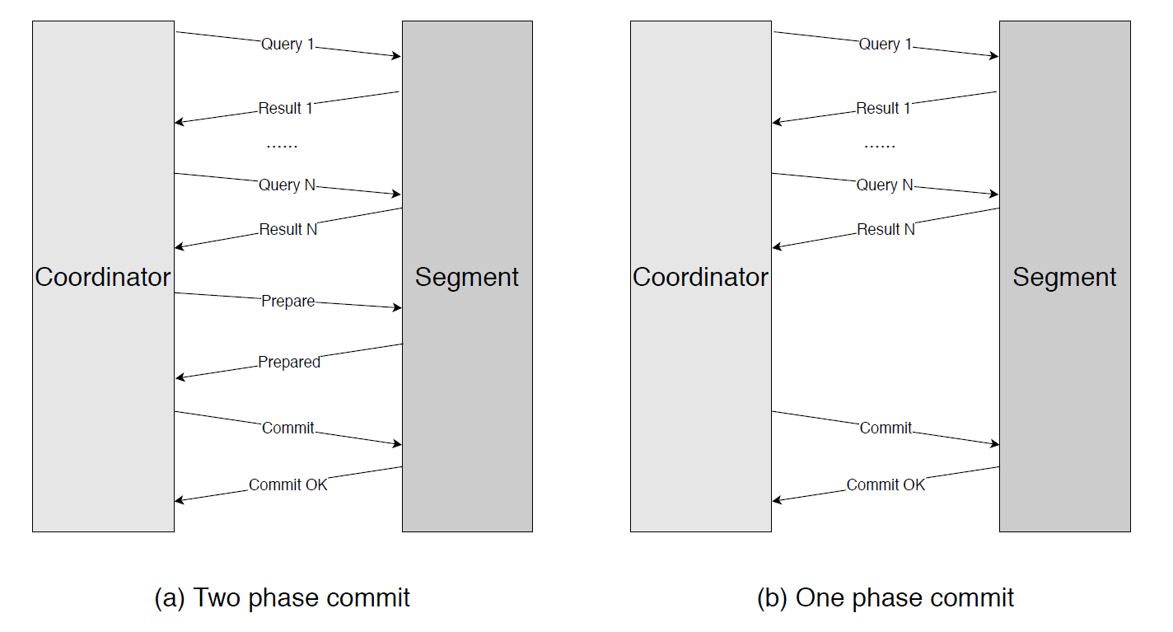
One-Phase Commit Protocol
One-phase commit is an optimization for transactions that update data on exactly one segment.
Source: Lyu, Zhenghua et al. Greenplum: A Hybrid Database for Transactional and Analytical Workloads, SIGMOD '21: Proceedings of the 2021 International Conference on Management of Data.
Notes:
The coordinator uses two phase commit to ensure that a transaction is either committed or aborted on all segments. The coordinator creates a backend process to handle a client connection. The backend
process initiates two-phase commit protocol among participating segments, upon receiving commit request from client. The protocol itself and the overhead incurred by it are well studied in literature.
Any optimization in two phase commit not only makes the commit process shorter but also causes locks to be released quicker, leading to improved concurrency.
The coordinator can determine whether a write operation happens only on one segment. If so, the coordinator skips the PREPARE phase and dispatches the commit command to the participating segment. One-phase commit saves one network round-trip of PREPARE message and file system sync operations for (1) PREPARE on segments and (2) COMMIT on coordinator.

Slide 49
Resource Isolation
CPU isolation is implemented based on Linux control groups (cgroup).
Memory isolation is implemented based on the memory management module Vmemtracker.
For CPU resources, we assign more CPU rate limit to the transactional resource group, since transactional queries are short and sensitive to query latency.
Higher memory limit is assigned to the analytical resource group to allow analytical queries to use more memory and to avoid spilling to disk excessively.
Future work is going on to introduce a workload prediction module, which allows a query to use more memory when the prediction of incoming workload is heavy, even when not set to do so.
Notes:
How to alleviate the performance degradation caused by resource competition in a highly concurrent, mixed workload environment is a challenging problem.
Typically, analytical workloads will consume lots of CPU, memory, and IO bandwidth, which will preempt the resource for transactional workloads and cause transactional queries to be delayed.
To reduce the interference, Greenplum introduces Resource Group to isolate the resource among different kinds of workloads or user groups. Currently, resource group supports to isolate compute and memory resources with different technologies.
CPU Isolation is implemented with Linux Control Groups. We can assign limits regarding CPU Rate Shares and CPU Core Shares to resource groups.

Slide 50
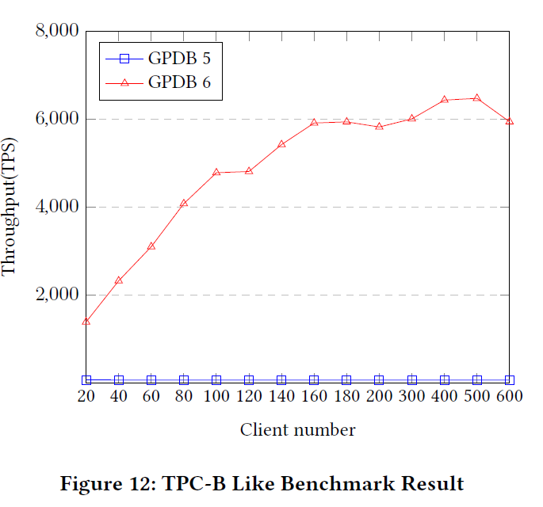
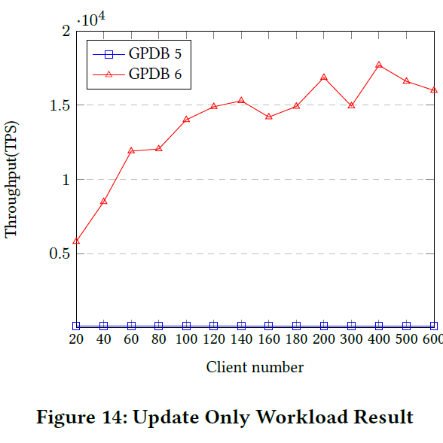
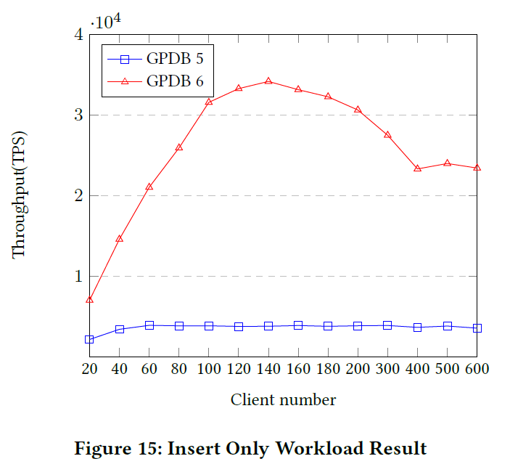
Performance Comparison
OLTP Performance (TPC-B Like Benchmark)
Source: Lyu, Zhenghua et al. Greenplum: A Hybrid Database for Transactional and Analytical Workloads, SIGMOD '21: Proceedings of the 2021 International Conference on Management of Data.
Notes:
Prior versions of Greenplum was as a traditional data warehouse with low transactional processing capability and latency of data analysis caused by batch processing. The new improvements are introduced to improve the overall OLTP performance, but Greenplum still caters primarily to the big data analytics space. In contrast, other HTAP systems like CockroachDB and TiDB focus primarily on transactional queries on terabytes of data and try to reduce the time to perform OLAP queries. These systems do have improved OLAP performance, but do not query peta-bytes of data like Greenplum.
FIGURE 1 (TPC-B measures throughput in terms of how many transactions per second a system can perform, basically a stress test)
We can see GPDB 6 processes 80 times more than its predecessor, thanks directly to the OLTP optimizations made.
One interesting thing here is that beyond 100 clients, the growth in throughput reduces and finally at 600 clients, the throughput starts to decline. Our analysis indicates that the decline is due to the bottleneck shifting to LWLock. This is being address in the future versions of GPDB.
FIGURE 2 (GDD Optimization)
GPDB 5 must serialize update operations on the same table, whereas the global deadlock detector enables GPDB 6 to permit concurrent updates to the same table.
We see 100x improvement.
FIGURE 3 (One-phase commit Optimization)
Each insert statement in this workload inserts values that all map to a single segment. One-phase commit optimization can be applied to such transactions.
GPDB 6 can process 5 times more transactions per seconds than GPDB 5.

Slide 51
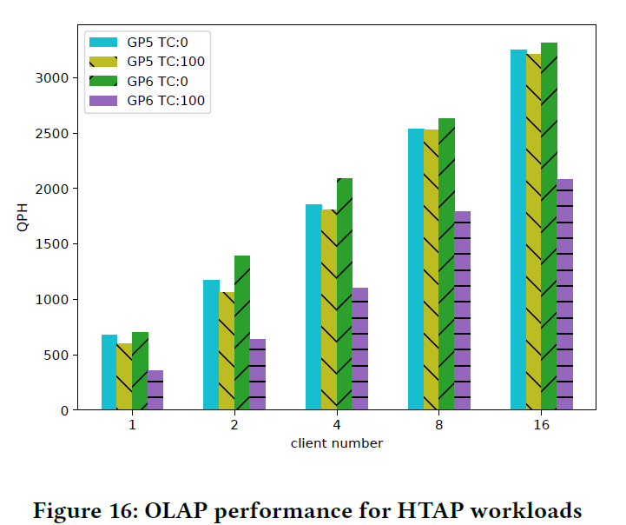
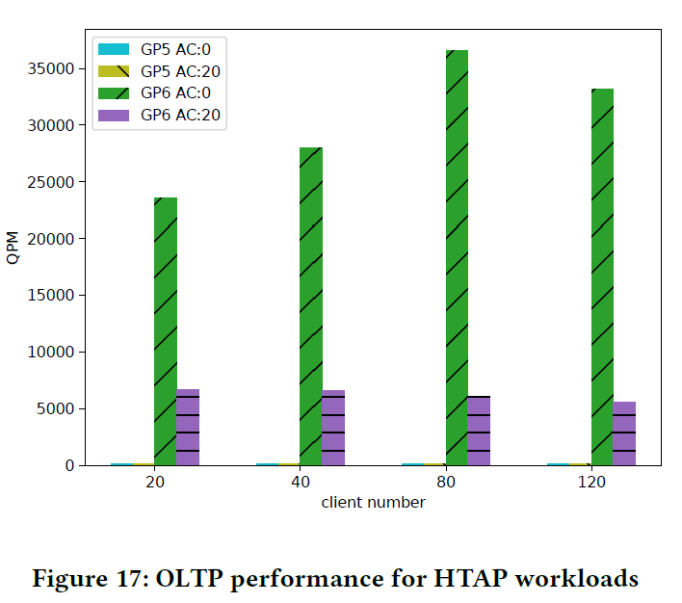
Performance Comparison
HTAP Performance (CH-benCHmark)
Source: Lyu, Zhenghua et al. Greenplum: A Hybrid Database for Transactional and Analytical Workloads, SIGMOD '21: Proceedings of the 2021 International Conference on Management of Data.
Notes:
To evaluate the performance of Greenplum on HTAP workloads, the CH-benchmark was used, a widely used HTAP benchmark. CH-benCHmark is a hybrid benchmark, which is composited of TPC-H OLAP benchmark as well as TPC-C OLTP benchmark.
FIGURE 1
Figure 16 shows the queries per hour (QPH) of OLAP workload with various OLAP client numbers and two fixed OLTP client numbers: 0 and 100, respectively. This experiment demonstrates the impact of OLTP workloads to OLAP workloads. Result shows that the OLAP performance has more than 2x slowdown on QPH in GPDB 6 but has no significant difference in GPDB 5. This is because the OLTP queries per minute (QPM) in GPDB 5 is too small to preempt the resource of OLAP workloads.
FIGURE 2
To better evaluate the impact of OLAP workload to OLTP workload, we compare the QPM number of OLTP workloads with various OLTP client numbers and two fixed OLAP client number settings: 0 and 20. Figure 17 shows that there is 3 times performance reduction for OLTP performance on GPDB 6, while there is no difference on GPDB 5, since the QPM number is limited by the lock conflict instead of the system resource. This shows that GPDB 6 is able to handle ten thousands of OLTP queries and executes complex ad-hoc queries at the same time.

Slide 52
Project Plan
Study HTAP systems with diverse architectures (e.g. data organisation and synchronization)
Compare and Contrast such systems based on their design decisions
Assess the strengths and weakness of these systems (in terms of AP/TP throughput, scalability, among others)
Study the systems that have evolved from OLTP to HTAP (e.g. MemSQL, IBM dashDB, and more)
Summarize all the systems studied and create a taxonomy based on design and performance
Notes:
Snowflake unistore
polarDB
AlloyDB

Slide 53
Project Timeline
Survey Project Timeline
Milestone 1
Oracle Dual Format
Milestone 2
PolarDB
Milestone 3
(Conclusion)
Study of the next 3 HTAP systems
SingleStore
Greenplum DB
SAP HANA
TiDB
Summarize all the systems studied and create a taxonomy based on design & performance

Slide 54
Thank YOu

